Slide 1

AI Workshop
By Muhamad Nur Rohman
Day 3
July 7, 2022

Slide 2
Topics
1. Dataset pre-processing | : | Normalization (input and output) | Day 1
 |  | Randomization (shuffle)
 |  | Dataset division (training, validation, and testing)
 |  | Dataset division using cross validation
2. Variable importance analysis | : | Random forest | Day 1
3. AI-based modeling | : | Support vector machine (SVM/SVR) | Day 2
 |  | Random forest for classification/regression
 |  | ANN/DNN
4. Metaheuristic optimization | : | Particle swarm optimization (PSO) | Day 3
5. Hybrid AI-based model – metaheuristic optimization (Hyperparameter tuning) | : | SVR-PSO ANN-PSO DNN-PSO ANN/DNN fine-tuning | Day 4
6. Optimization using machine learning model | : | PSO-SVR | Day 5
7. Object measurement | : | Computer vision / OpenCV | Day 6

Slide 3
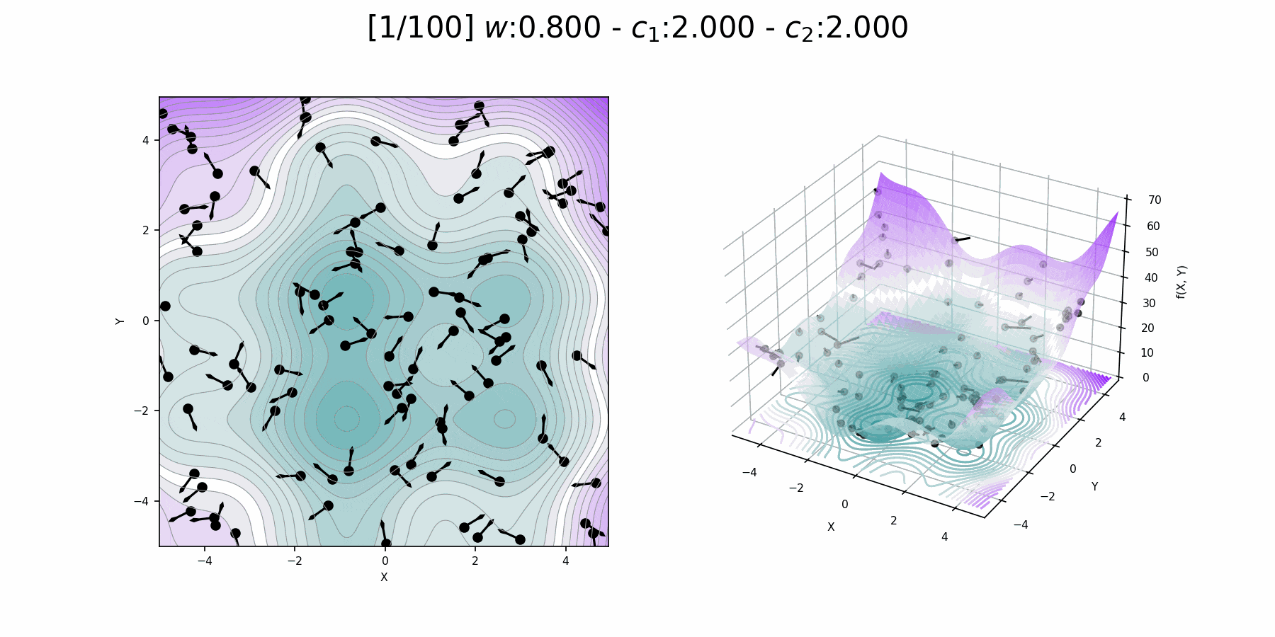
Particle Swarm Optimization (PSO)
PSO is a computational method that optimizes a problem by iteratively trying to improve a candidate solution with regard to a given measure of quality.
It solves a problem by having a population of candidate solutions, here dubbed particles, and moving these particles around in the search-space according to simple mathematical formula over the particle's position and velocity.
Each particle's movement is influenced by its local best known position (Pbest), but is also guided toward the best known positions in the search-space (Gbest), which are updated as better positions are found by other particles.
This is expected to move the swarm toward the best solutions.

Slide 4
Population initialization
Evaluate the fitness
Save the Pbest and Gbest
Update the rate and position
Boundary handling
N
Stopping criteria satisfied?
Y
Optimal solution

Slide 5
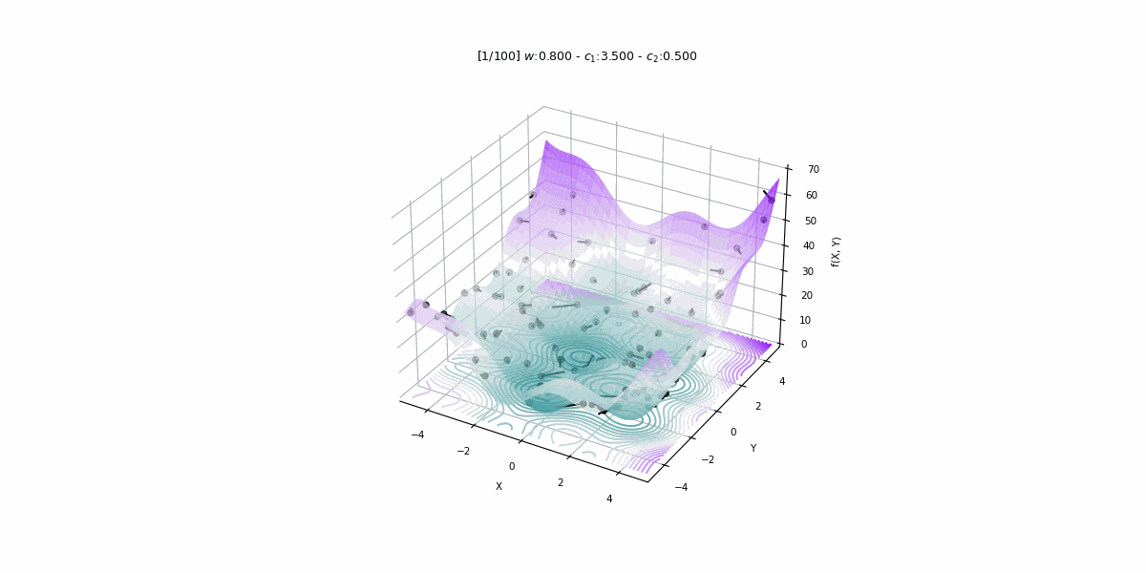
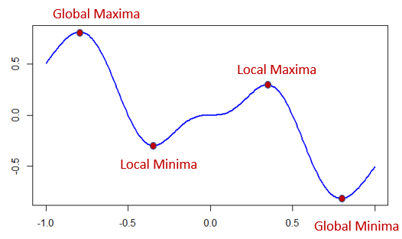
Local Vs. Global Optima (Maxima or Minima)
Objective: reach the global minima
Local minima
Global minima

Slide 6
Boundary crossing problem
Boundary of solutions
Boundary handling
6
if Xi < LB:
Xi = LB + rand(0,1)*(UB-LB)
elif Xi > UB:
Xi = LB + rand(0,1)*(UB-LB)
LB = lower bound
UB = upper bound
5
4
y
3
2
X(7,2)
1
0
0
1
2
3
4
5
6
x

Slide 7
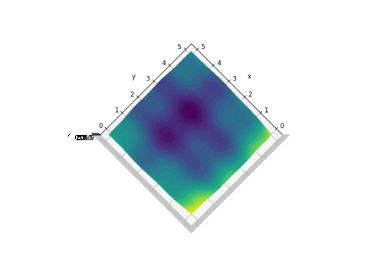
Exercise 13
z = (x-3.14)² + (y-2.72)² + sin(3x+1.41) + sin(4y-1.73)
Objective
Minimize: z
Subject to:
0 ≤ x ≤ 6
0 ≤ y ≤ 6

Slide 8
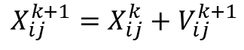
X_{i,j} = LB_{j} + rand(0,1)*(UB_{j}-LB_{j})
Population initialization
Variable | LB | UB
x | 0 | 6
y | 0 | 6
Evaluate the fitness
Save the Pbest and Gbest
z = (x-3.14)² + (y-2.72)² + sin(3x+1.41) + sin(4y-1.73)
Update the rate and position
$$V_{ij}^{k+1}=wV_{ij}^{k}+c_{1}r_{1}\left({Pbest}_{ij}^{k}−X_{ij}^{k}\right)+c_{2}r_{2}\left({Gbest}_{j}^{k}−X_{ij}^{k}\right)$$
Boundary handling
$$X_{ij}^{k+1}=X_{ij}^{k}+V_{ij}^{k+1}$$
N
Stopping criteria satisfied?
Maximum number of iteration or convergent
Y
Optimal solution

Slide 9
Population
Pbest (best population):
The best population so far in which each particle results the best fitness
Particle No. | x | y | Fitness
1 | 1.84 | 0.44 | 0.43
2 | 1.04 | 3.16 | 0.81
3 | 0.75 | 5.82 | 0.14
4 | 3.45 | 4.00 | 0.87
… | … | … | …
N | 3.39 | 4.68 | 0.94
Gbest
Gbest (global best)
The best particle so far which results the best fitness
0 ≤ x ≤ 6
0 ≤ y ≤ 6

Slide 10
Memory saving
The fitness value of each particle in updated population in the current iteration
The fitness value of each particle in Pbest of the previous iteration
fc-1
fc-2
fc-3
…
…
fc-N
fp-1
fp-2
fp-3
…
…
fp-N
The smallest of (fc-i, fp-i)

Slide 11
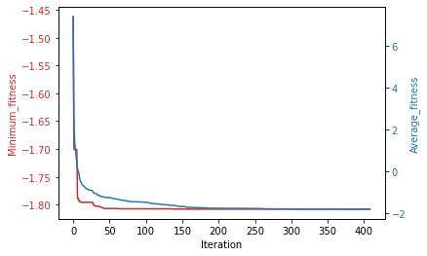
Fitness history
Stopping criteria: reach max. iteration or convergent

Slide 12
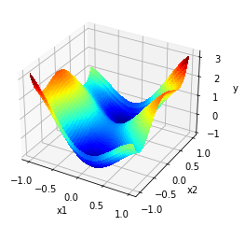
Exercise 14
$$y=4x_{1}^{2}−2.1x_{1}^{4}+\frac{1}{3}x_{1}^{6}+x_{1}x_{2}−4x_{2}^{2}+4x_{2}^{4}$$
Objective
Minimize: y
Subject to:
-5 ≤ x₁ ≤ 5
-5 ≤ x₂ ≤ 5

Slide 13
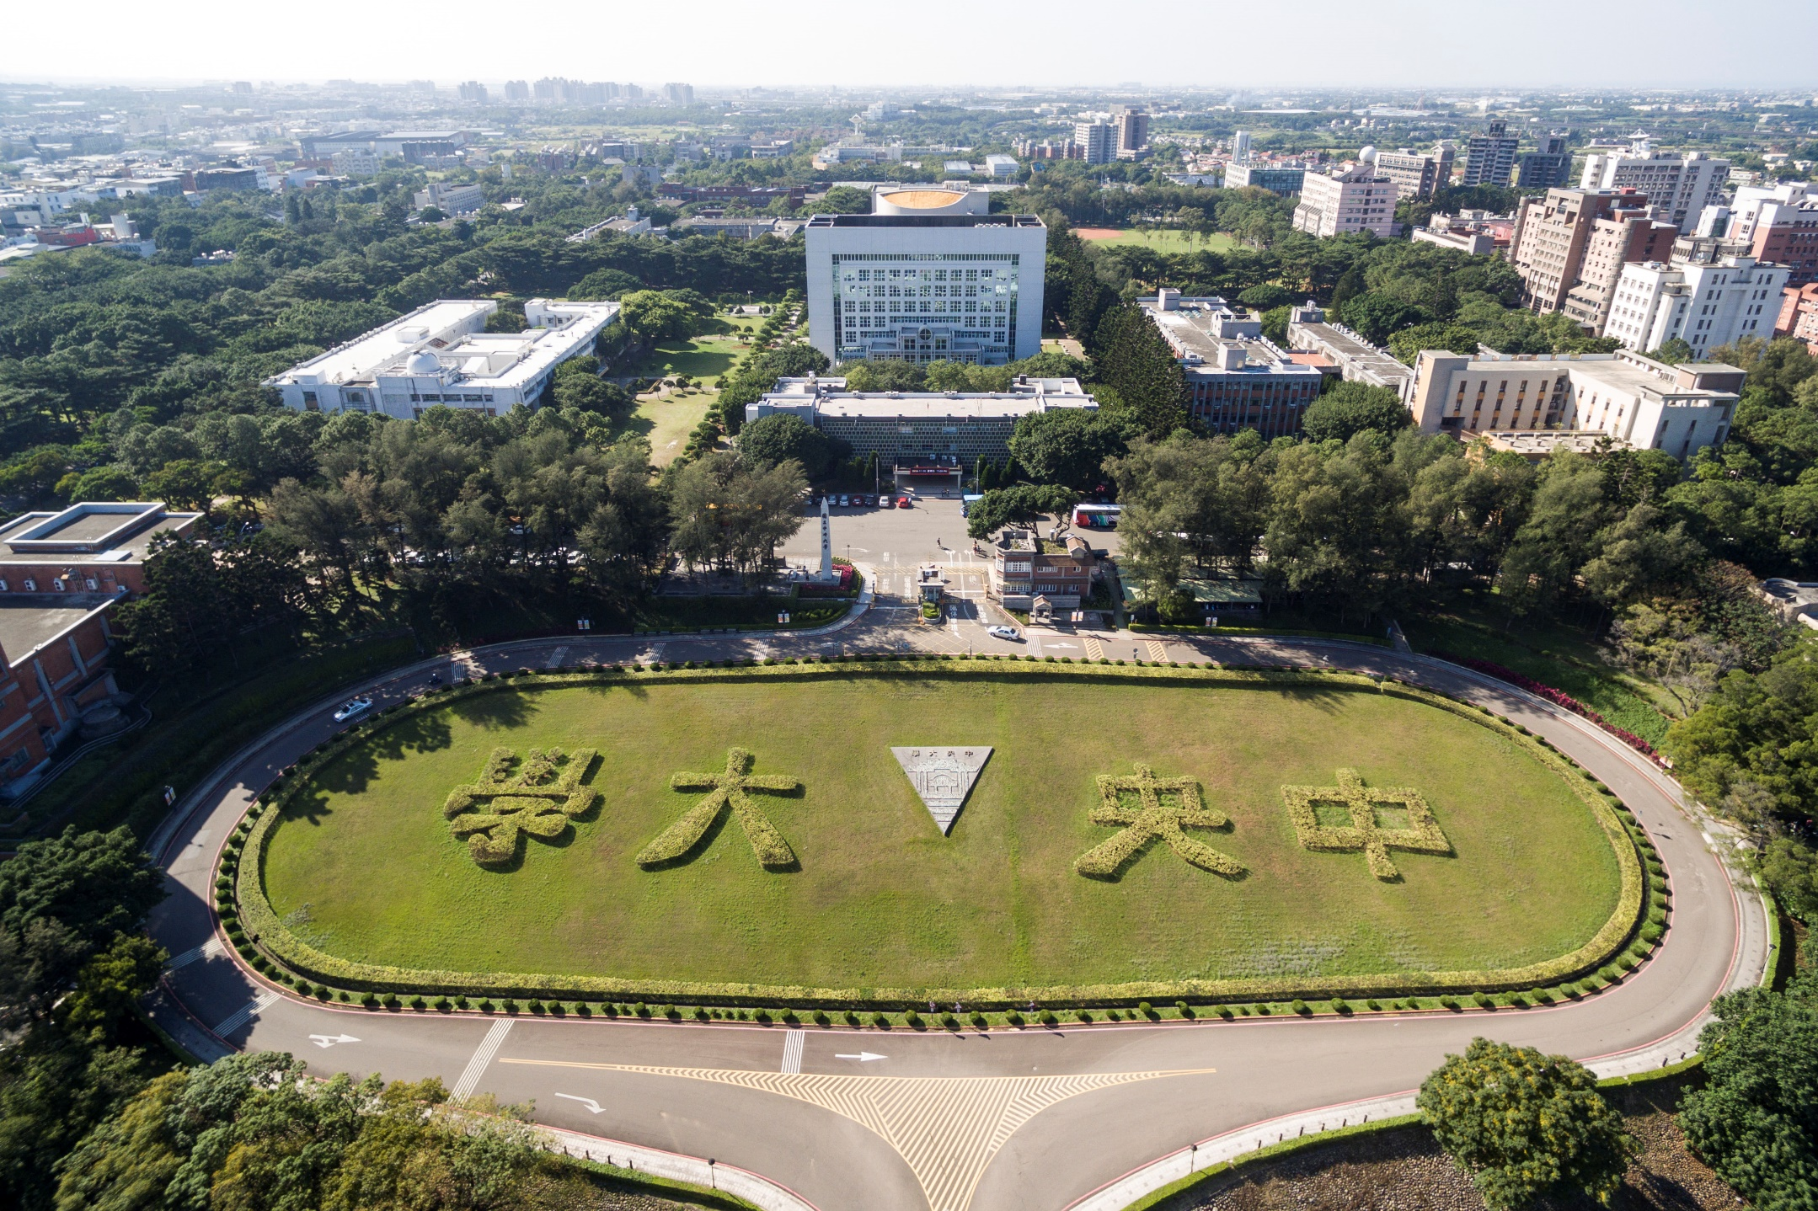
Thank you for your attention

